Slide 1

FOR A LIFE WELL LIVED
Condolence messages from Family, Friends & Well-wishers

Slide 2
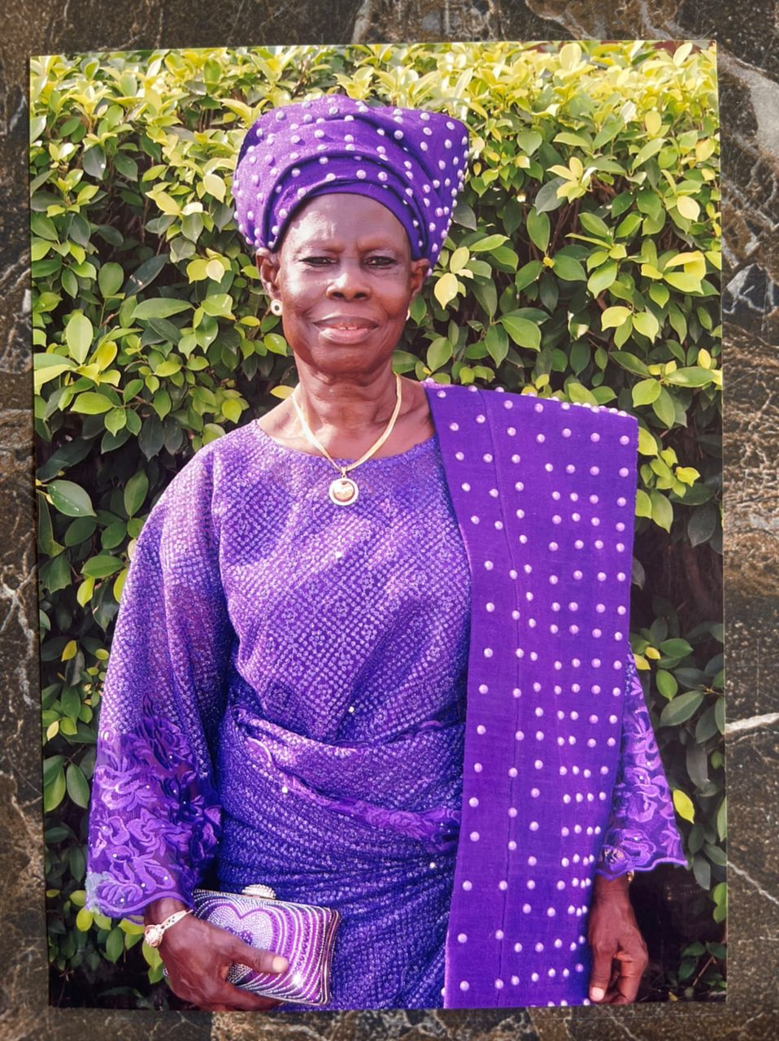
Yi o Ma Dun ni, koni kan
You went home at the time we were beginning to show you more gratitude for your labor over us. But I feel profoundly honored, blessed and proud that you were my mother.
Missing you is a heartache that will never go away but your life will remain a constant reminder that there is no greater way to honor you than to be a better me and uphold the love and peace you lived and died for.
No doubt your parting has left a deep crater but we will fill it with memories of joy, laughter, friendship and joyous moments that we shared.
Yes, Maami, these things we shall miss very much. I fervently pray that, all you’ve prayed for us during your lifetime continue to follow us until our last breath. Enjoy your deserved peace with the Lord, till we meet again to part no more…

Slide 3
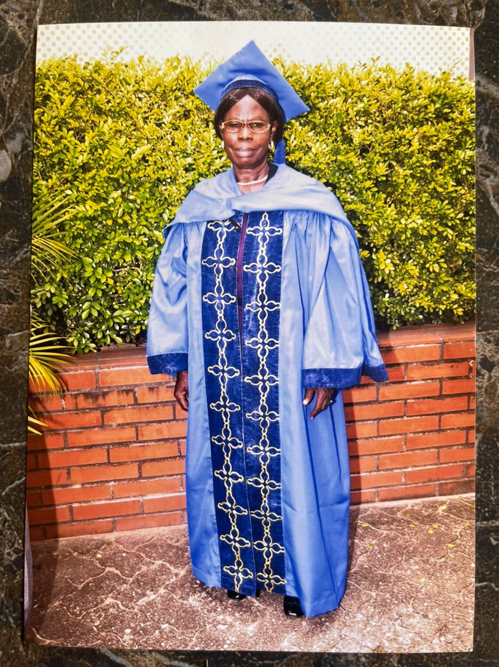
Death is inevitable, it is a journey that everyone must take. Often times we wish death wasn’t a part of life, we wish we would just stay alive on earth with our near and dear ones not dying.
But unfortunately, we cannot. Our prayer is that we fulfill our days on earth and grow old before our time is up. I pray your departed soul rest in perfect peace.
Adieu iya ewe!
-Yomi Dada
If we live, we live for the Lord, and if we die, we die for the Lord. so, whether we live or die, we belong to the Lord.
(Romans 14:8)
Keep resting in the Lord mama.
- Pastor V.O. Amusa

Slide 4
When my heart aches, I remember your sweet words and prayers, which infused me with peace. Every morning, I awake wishing life were different, with my heart full of longings.
It makes such a difference to have your comforting presence and support in my life. You are active and brave.
You have been a mother and at the same time, a sister to me. I pray in your next life, I become a biological child to you. Rest in peace mama.
-Mrs Fadaini Yemi
My heart is heavy . I am ineffably grieved on the demise of our mother Chief Agnes Shodipe aka Yio Ma Dun Ni ,an exemplar in hospitality, forthright and outspoken.
I can neither write , speak enough nor capture in totality the multitude of good deeds, good will your life dispensed to those who are lucky to cross your paths.
You are a compassionate , disciplined woman with a big heart that had room for negativity. Your departure had left a big vaccum, in Shodipe family, that will be highly improbable if not impossible to fill . Yes you lived an impactful life.. Rest in peace.
- Chief Ademola Adekoya

Slide 5
Iya Ewe, you fought a good fight of faith, and you ended it so well. We are all a living testimony of your good deeds and acceptance.
You were there for me on my final journey into the Shodipe family, you are a mother of all and a strong pillar of faith in God’s Kingdom.
Continue to rest with your creator till we meet again...good night mama
-Kemi Shodipe
Iya Sho is a very loving and kind woman. Knowing her has been a great privilege because she has not only shown love towards my daughter but to my entire family.
She lived her life consistently intervening of behalf of others in prayer.
Mama yi o ma dun ni! Ko ni kan! Sun re oo !!!
-Princess Akinola

Slide 6
-Toyin Shodipe
Tribute – You were the other mother I received even before I married your son. You gave me a gracious man with whom I share my life. I thank God for blessing me with the gift of you.
You stood by me through thick and thin and loved me as your own. You made yourself available to me whenever I needed someone to talk to. You were my mother, friend, gist partner and prayer partner. Thank you for taking really good care of your grandchildren.
You understood every bit of me and accepted me as I am. Your death was really sudden and I’m still saddened and heartbroken by your passing. I thank God for the wonderful and impactful life you led, as a lover of God and his word.
You came, you saw and you conquered. You fought a good fight of faith. My consolation is in Isaiah 51:7 – “God takes away the righteous before the days of eviI know and believe you have gone to heaven to join the angels
Continue to rest on “abiyamo tooto” Yio ma dun ni, Ko ni kan

Slide 7
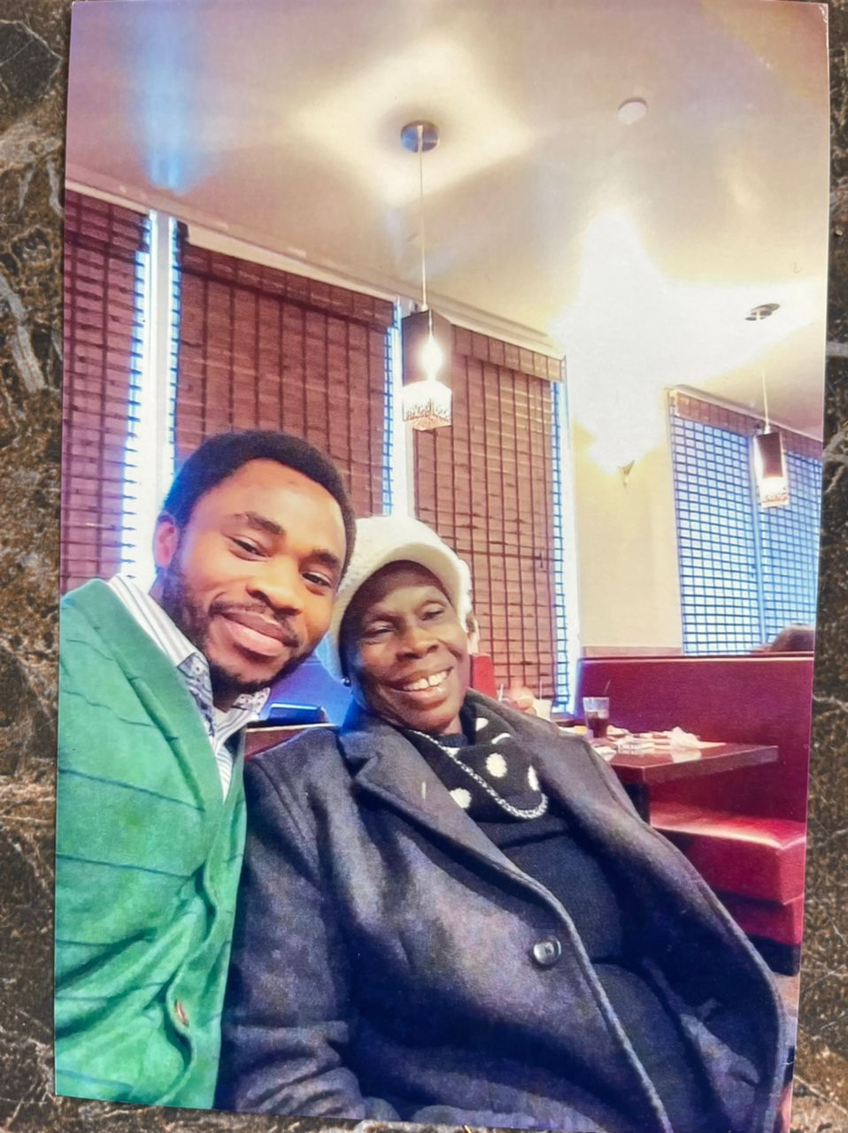
-Adewale Shodipe (Son)
Mama, we thank God for the exemplary and wonderful life you lived.as a seasoned administrator and teacher of the word, you taught us to love God and serve him accordingly.
You were kind to all and sundry that crossed your path, you touched lives differently in the most amazing ways, caring for friends, family members and strangers alike.
Though I’m still in total shock and disbelief as a result of your passing because nothing gave a clue or pointer to it, but I’m consoled with the legacies you left behind and memories of everything you were and stood for has continue to flood my heart daily.
Keep resting in the bosom of our Lord Jesus Christ.
Adieu Iya Ewe

Slide 8
Bukola Shodipe (son)
Maami, I would never have thought I will be writing this so soon, Never. not even in the nearest future, I’m still in total denial and I hope I can wake up from this reality dream some day soon.
You were my everything after God, enough for me the only one I need in a million, you stood by me every night and day as I race through life and it challenges.
You taught me patience, being reliable, dedication, integrity, commitment, truthfulness and not the lest hardwork, cause to you (ise logun ise) you were too good to be true, you always stand by the truth and what is right, your service to God and humanity is worthy of emulation.
Maami I appreciate all your sacrifices and long suffering over me, and my siblings, you nurtured me and many others in the way of the Lord and always encourage us not to depart from it.
You are a true definition of a proverb 31 woman. You’ve always shown it to the world that having good, well behaved and morally sound children(biological or not)are far better than riches and gold.
You were my greatest supporter, prayer warrior, best friend, gist partner, fight buddy and many more. I miss you each and every passing day but I know you are in a better place and had become my guardian angel, I’m happy your lagacies and the attestation of your good works and your remarkable deeds has started already,
I’m so proud of you Maami…you are simply the best even in death, I’m doing everything to become what you desire from God and of me. keep resting in the bossom of your creator till we meet to part no more.
Thanks for gifting/sharing your worthy, adorable and beautiful Life with us. And if I ever repeat this earthly journey even a thousand times, you will always be my precious mum.
I Love you Agnes till eternity and a day (True Abiyamo)

